Slide 1

Context-aware access to ontologies
Patrick Maué
Institute for Geoinformatics (IFGI)
pajoma@uni-muenster.de
Notes:
Name and Status,
Background,
Title: Web Services in the Geosaptial Semantic Web:
I will introduce you in the wonderful world of geographic information science, and the current state of the geospatial web. The problem is: it is a world without w3c standards, no wsdl , no soap , no fortunately no uddi.

Slide 2



Background
Context:
Geospatial Decision Making
Environmental Modelling
Why Ontologies?
Semantic Annotation of Web services to facilitate
Discovery & Integration
Semantic Validation of Workflows
http://purl.org/ifgi/projects/swing
http://purl.org/ifgi/projects/GDI-Grid
http://www.envision-project.eu

Slide 3
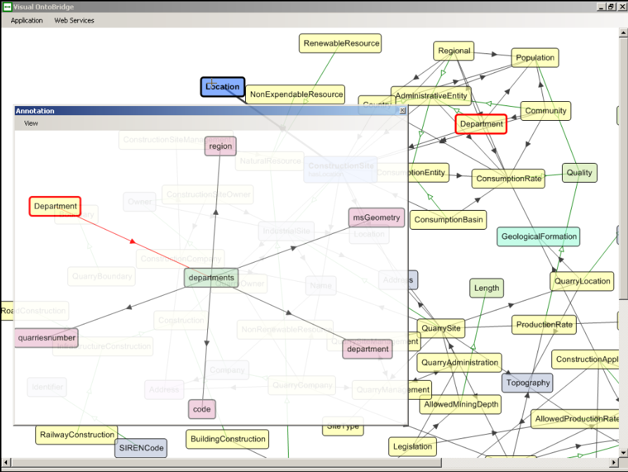
Using Ontologies for Semantic Annotations
Demo Video and Download on SWING website

Slide 4
Knowledge Acquisition
Specification
  Workshops with domain experts
  Concept Maps as results

Slide 5
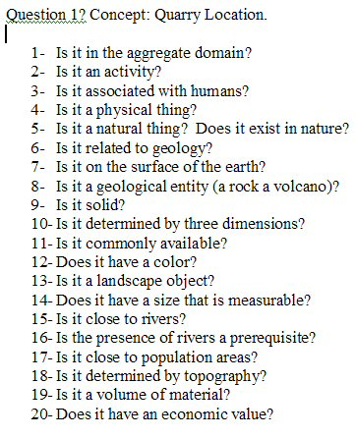
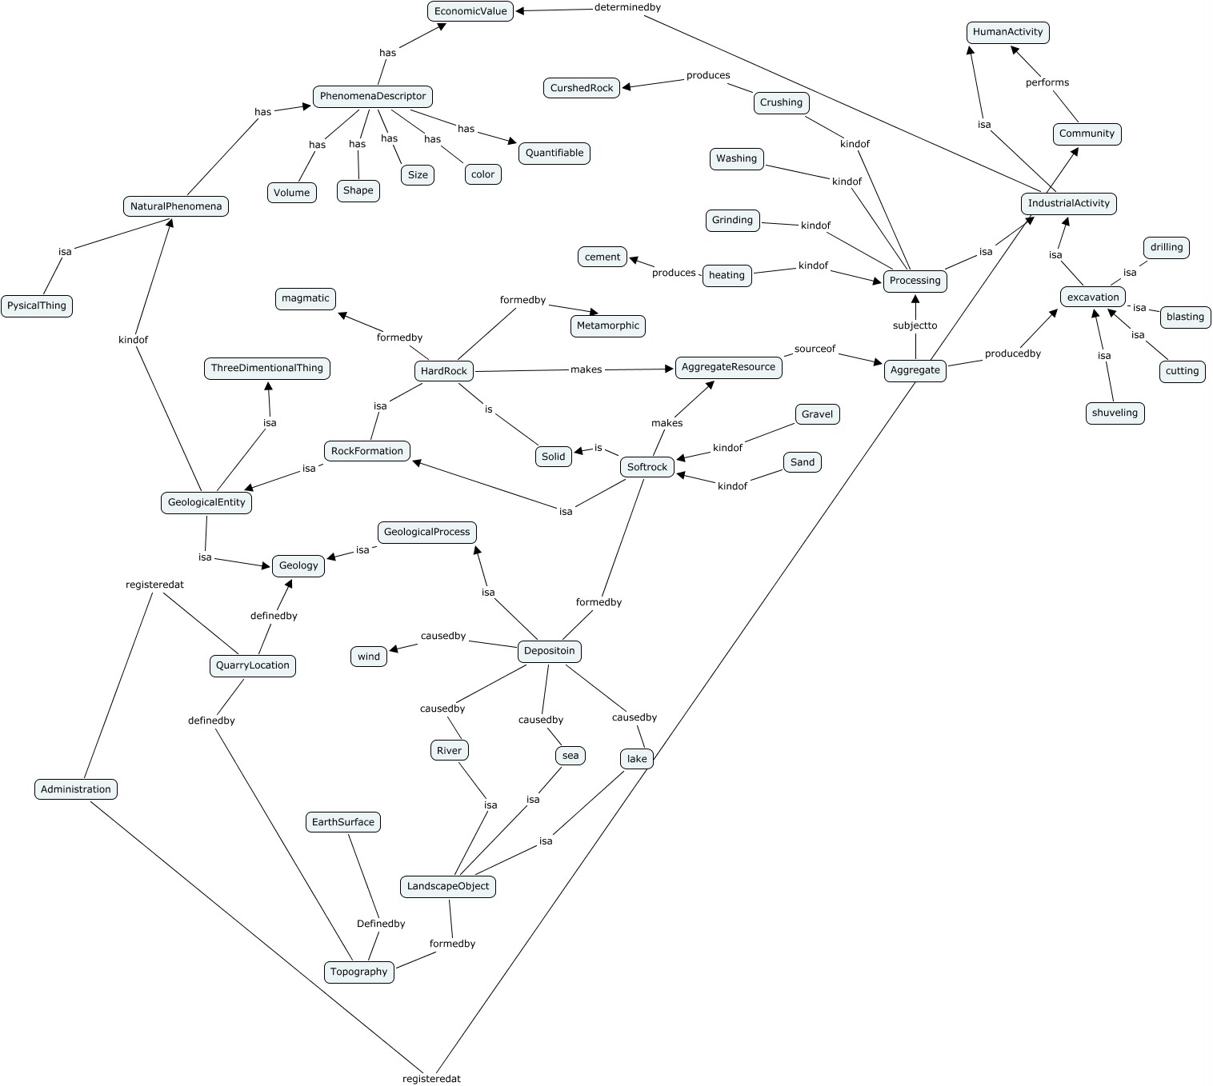
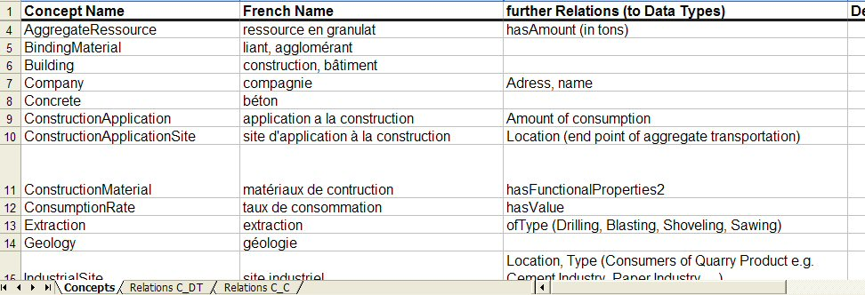

Slide 6
Ontology Engineering
Specification
  Workshops with domain experts
  Concept Maps as results
Implementation
  Using WSML

Slide 7
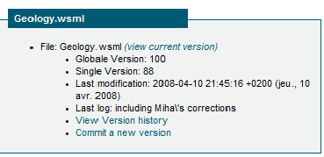
Serving the ontologies (1st Try)
http://swing.brgm.fr/repository/ontologies
  File-based approach (Ontology is a file)
  Versioning via Subversion

Slide 8
Serving the ontologies (1st Try)
http://swing.brgm.fr/repository/ontologies
  File-based approach (Ontology is a file)
  Versioning via Subversion
Drawbacks (also due to the lack of tools)
  No structural consistency checks
  Modularization difficult (borderline cases)
  Versioning on file-level

